Slide 1
FM Cross Band Repeater

Slide 2
High Level Needs (from Jonathan’s email)
Start with:
Single signal path
VHF voice signal transponded as a UHF voice signal
Could be a SDR w/digital radio chip
Could be analog
Fit onto a CubeSat board
Ideally 2” x 2” area
Radiation tolerant
Avoid CMOS

Slide 3
Goal
Per chat with Heimir (at least my interpretation):
Multiple repeaters on a single satellite
I.e., multiple up frequencies with multiple down frequencies
Mix of U/V and V/U (?)

Slide 4
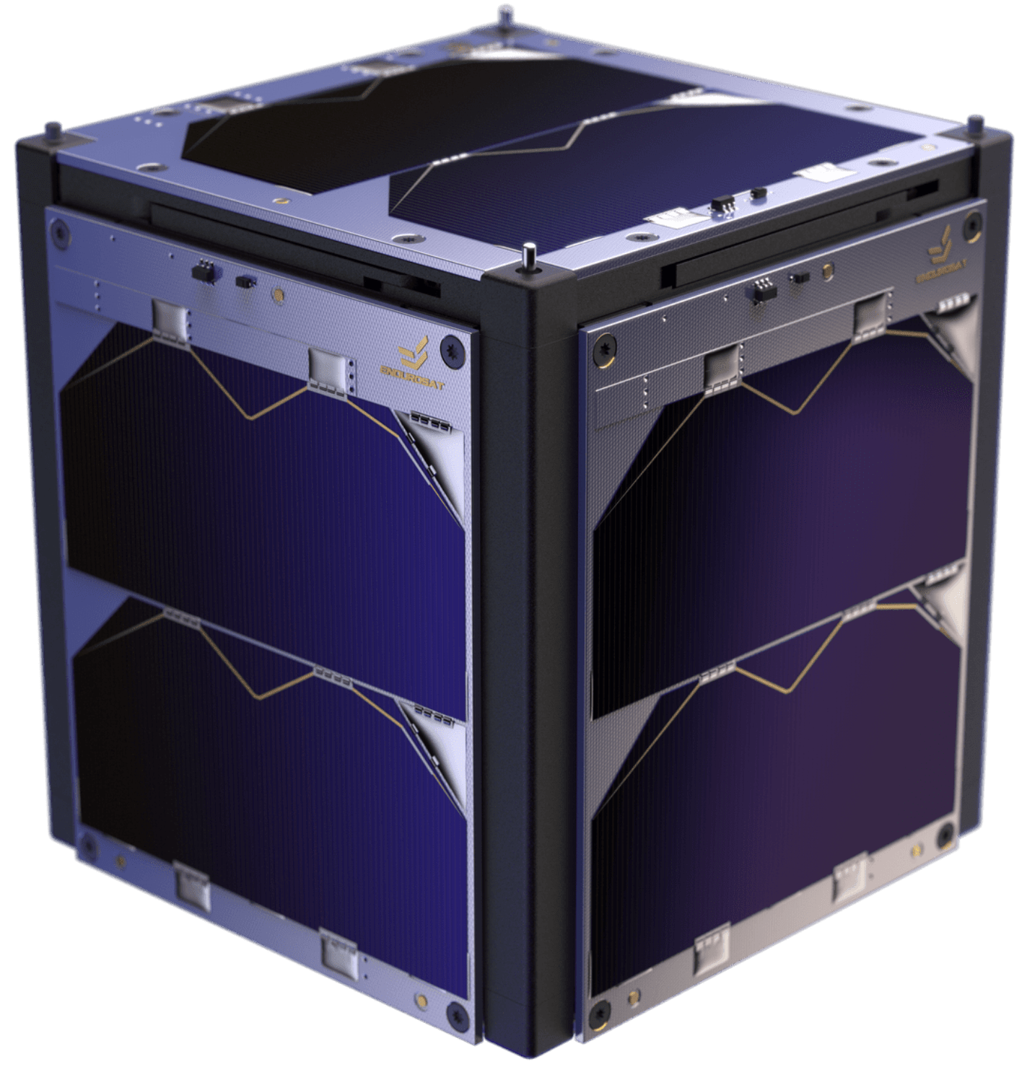




OV-1
Multiple (how many?) repeaters on a single satellite
Up in VHF
Down in UHF
f_{UHF,N}
f_{UHF,1}
f_{UHF,2}
f_{VHF,N}
f_{VHF,1}
f_{VHF,2}

Slide 5
Tasks
Survey of open-source designs

Slide 6
Questions

Slide 7
Assumptions

Slide 8
Requirements(-ish)

Slide 9
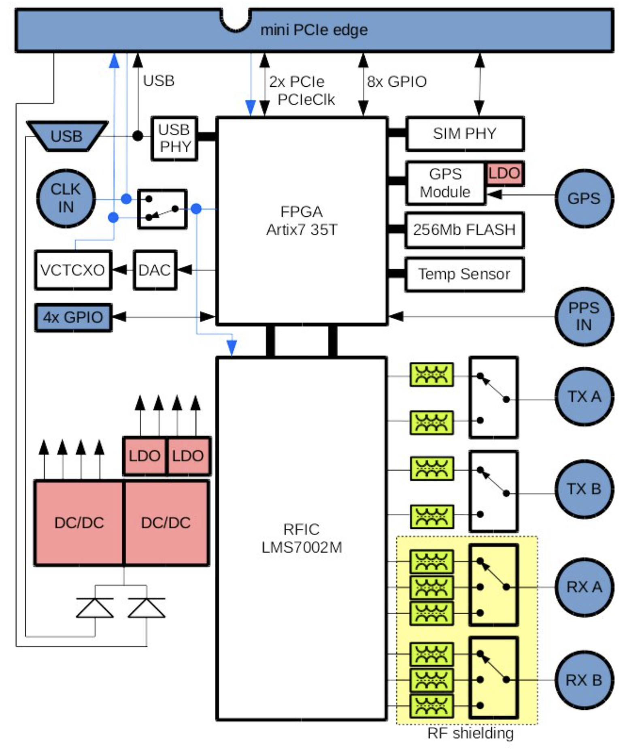
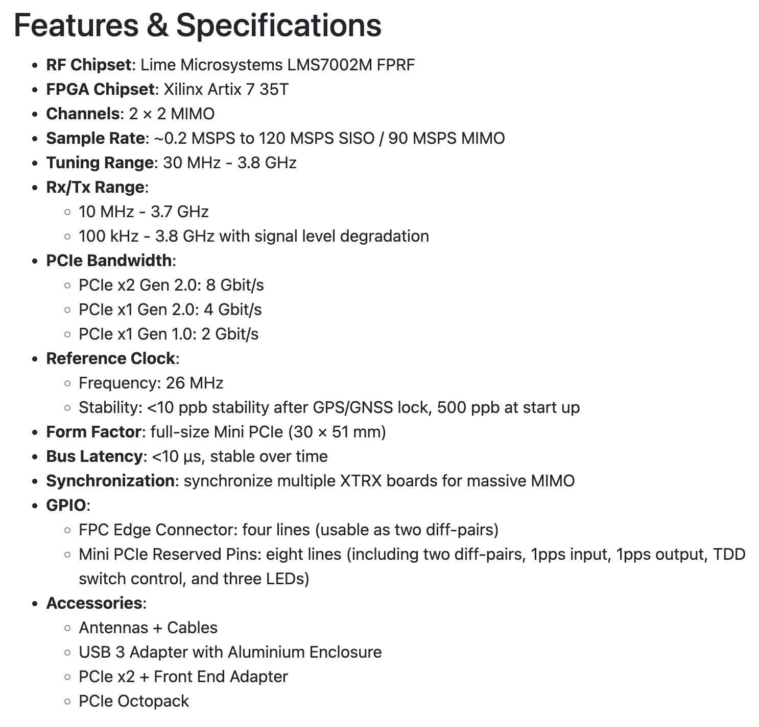
SDR
Fairwaves
XTRX
Source: https://www.crowdsupply.com/fairwaves/xtrx

Slide 10
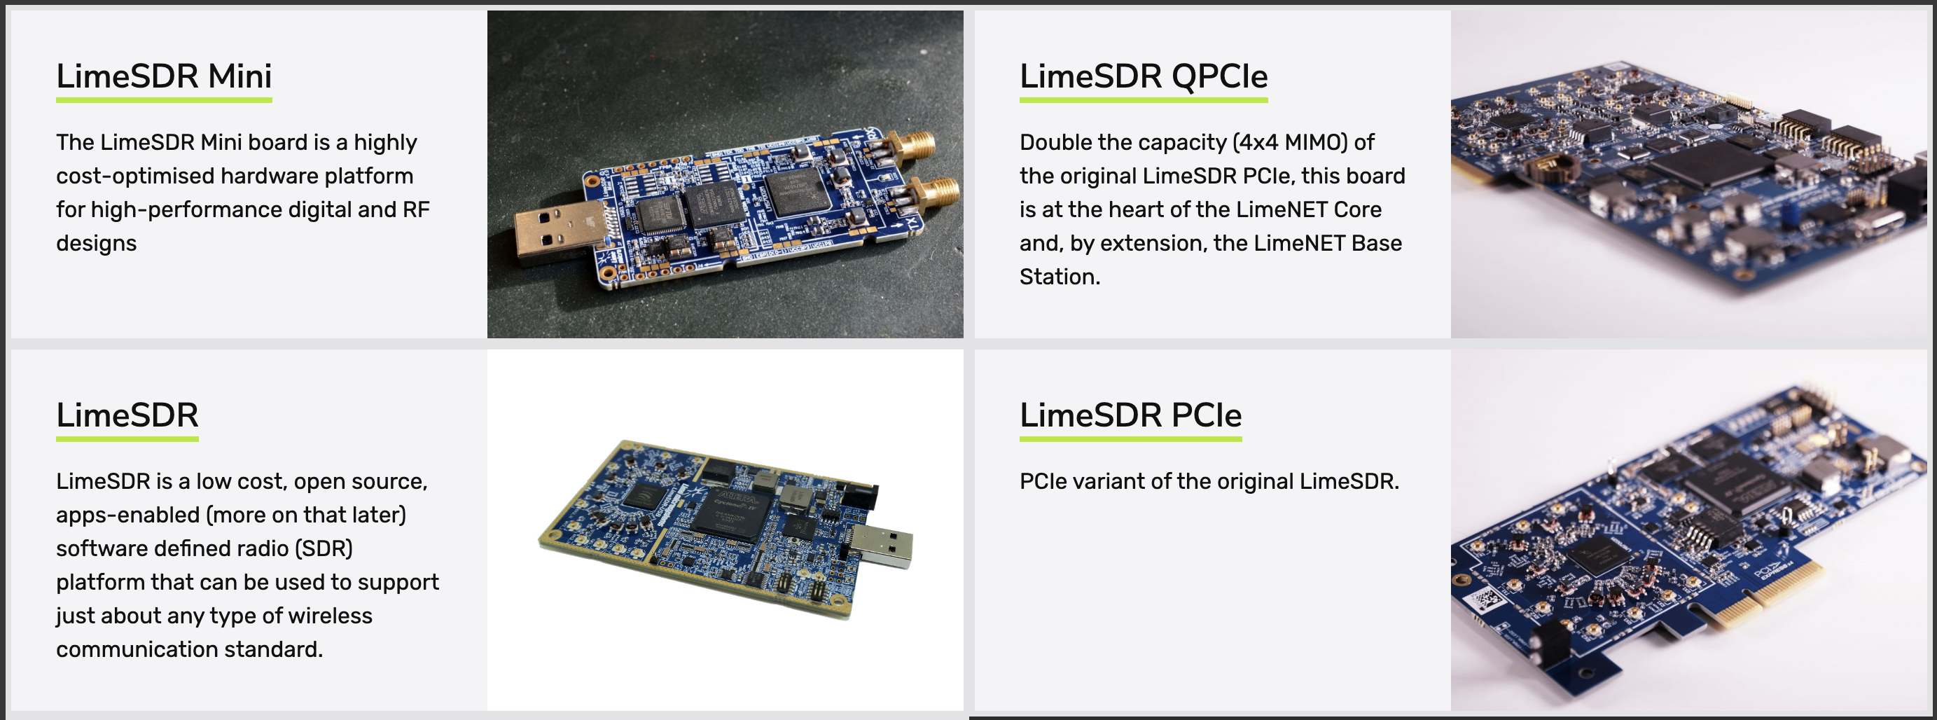
SDR
Lime Microsystems took over the XTRX (?)
Additional Options:
Source: https://limemicro.com/products/boards/

Slide 11
Backup

Slide 12
Repeater Basics

